Slide 1
My future
Monika Kordiaková

Slide 2
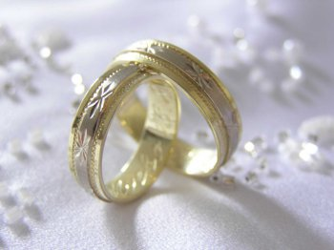
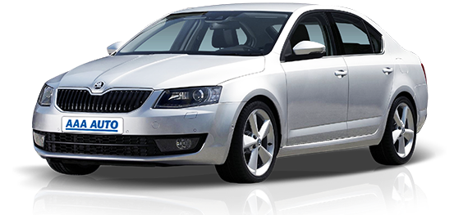
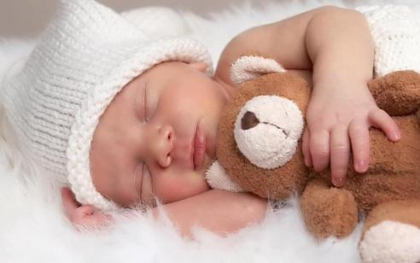
My ideal partner will be good friend.
I will learn to drive at 17 years. I will start work at 25 years. I will get married at 19 years. I will have children at 20 years.

Slide 3
i think i will write a book. I think I will not ever play in a national sport team.

Slide 4
I most want to be important and happy.

Slide 5
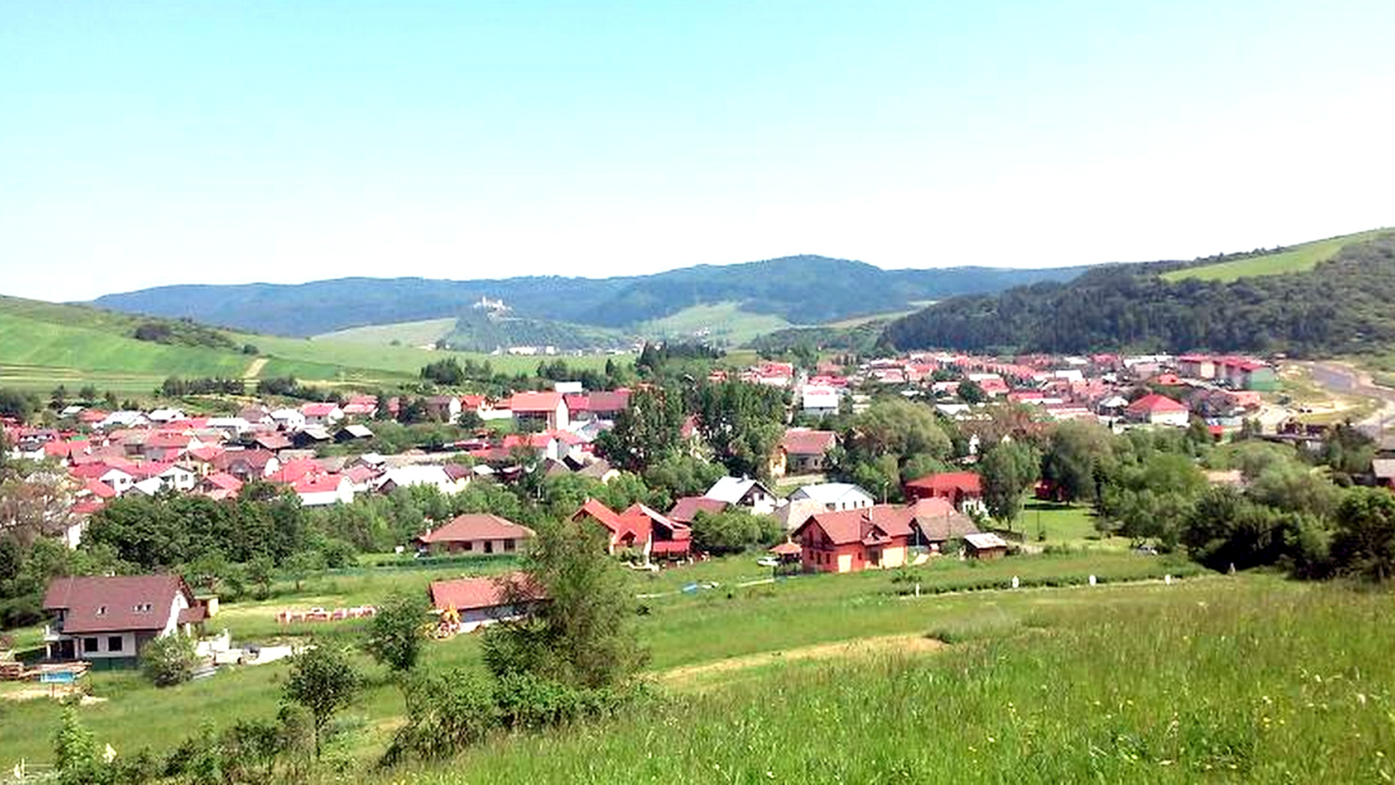
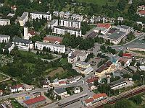
I will live in a village or a small town.

Slide 6
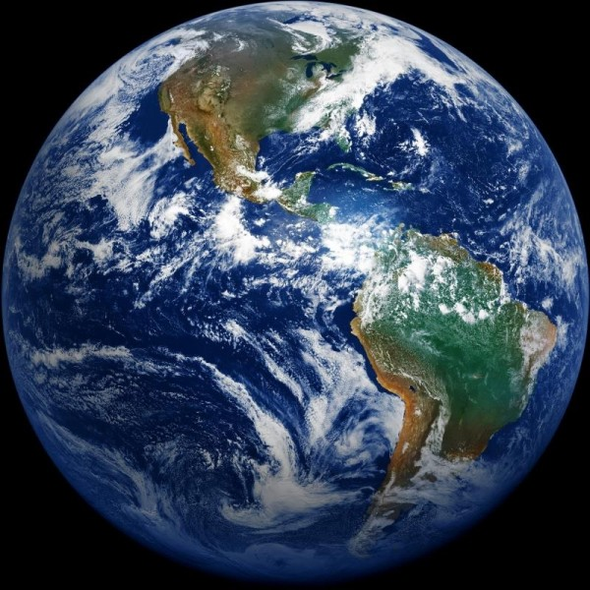
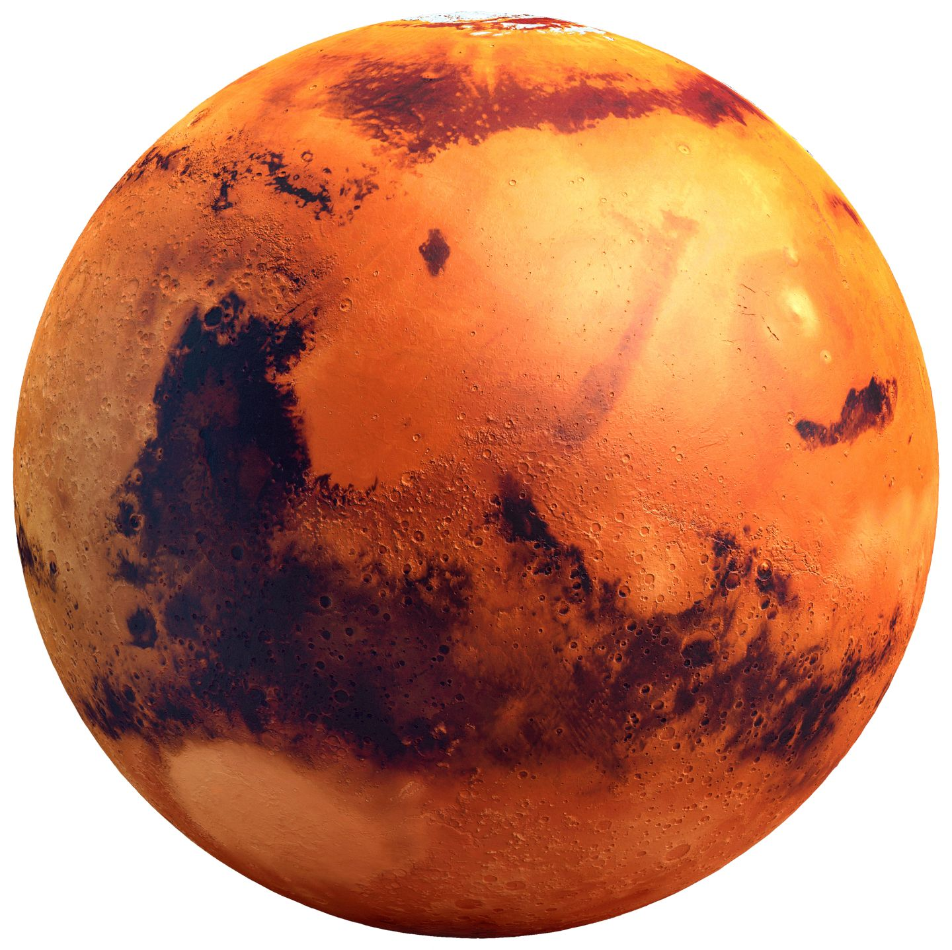
aliens won’t visit the Earth.People won’t live on Mars.

Slide 7
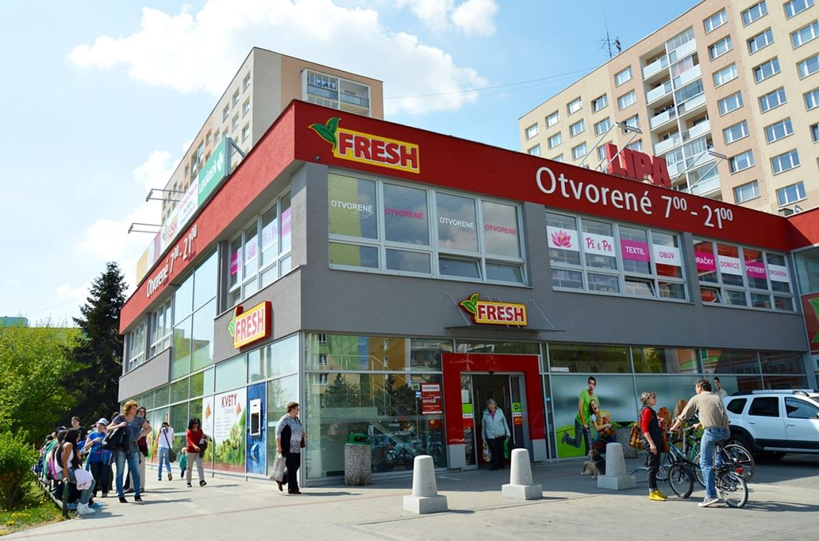
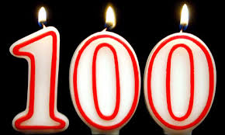
We will have cars in the future. We will have shops in the future.
I will live to be a hundread years old.

Slide 8
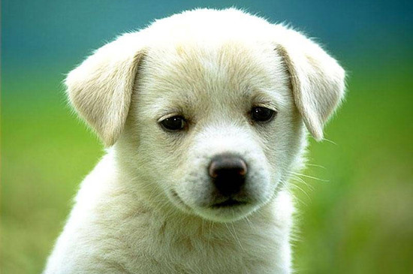
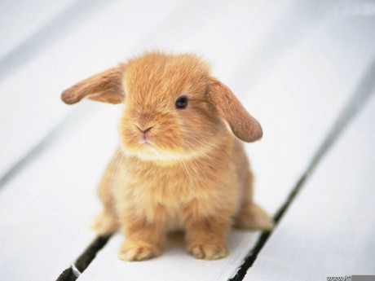
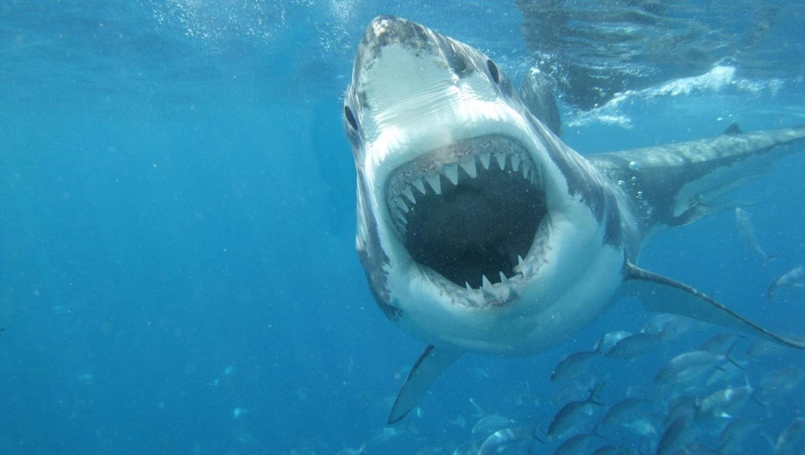
Many animals won’t become extinct.

Slide 9
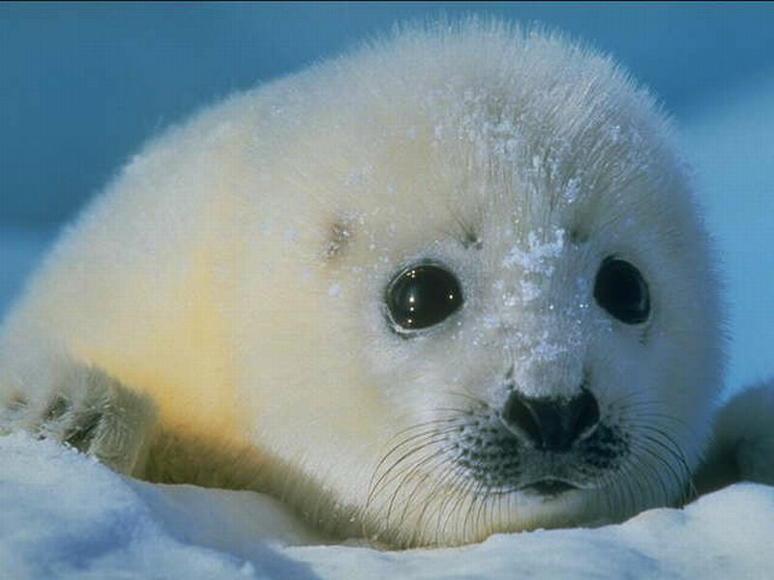
THANNKS FOR PAYING ATTENTION

